Slide 1
File Allocation in UNIX
Example
A UNIX system has a hard disk with a block size of 2 Kbytes. This system keeps track of disk space assignment using i-nodes containing 10 direct pointers as well as pointers for single and double indirect addressing. Assume that block addresses are 4-bytes long.
a) Find the maximum file size in the above disk.
b) If a file of 8221 Kbytes is stored in the above disk, find the corresponding wasted disk space.
c) What are the number of disk accesses required to open this file? Make any necessary assumptions.
c) To open file we need one disk reading access to read i-node, then one to read the single indirect block, then 1+8 to read the double indirect blocks . Thus 11 disk accesses are needed to open the file (data blocks are not counted since question is about “opening” file and not reading or writing its contents). We assumed that file is in current directory so place of its i-node is known without need for more accesses.
ELC 467– Spring 2019
Lecture 9 -Page 13

Slide 2

Master File Table of the NT File System
NT File System (NTFS) is an example of a more recent file systems, with advanced features that support large file systems, including:
64-bit disk addresses.
Long Unicode file names.
Possibility of multiple data streams per file.
Compression, encryption and journaling of files.
ELC 467– Spring 2020
Lecture 10 -Page 1
Notes:
As another example for management of files on still larger volumes, we consider the NT file system used currently in Windows. 64-bit addresses allows volumes with more clusters. Unicode allows using different languages. An example of file with multiple data streams is a file having mp3 sound as well as image displayed when sound is played. Journaling means keeping record of changes made in file.

Slide 3
Master File Table of the NT File System
NT File System (NTFS) is an example of a more recent file systems, with advanced features that support large file systems, including:
64-bit disk addresses.
Long Unicode file names.
Possibility of multiple data streams per file.
Compression, encryption and journaling of files.
The Master File Table (MFT) is a database that contains information on every file on an NTFS volume. It is a sequence of fixed size (1KB) records, each record describing one file.
ELC 467– Spring 2020
Lecture 10 -Page 1

Slide 4
Master File Table of the NT File System
Record contains the file’s attributes and a list of disk addresses where its clusters are located. Addresses are stored in the form of (disk address, run length) pairs.
ELC 467– Spring 2020
Lecture 10 -Page 2
Notes:
Attributes are information related to each file. Run length means the number of used clusters starting from the first address, without interruption. Thus (10,4) means 10-11-12-13. This form of address storage compresses the list of cluster numbers and takes less size, especially if file is not fragmented.

Slide 5
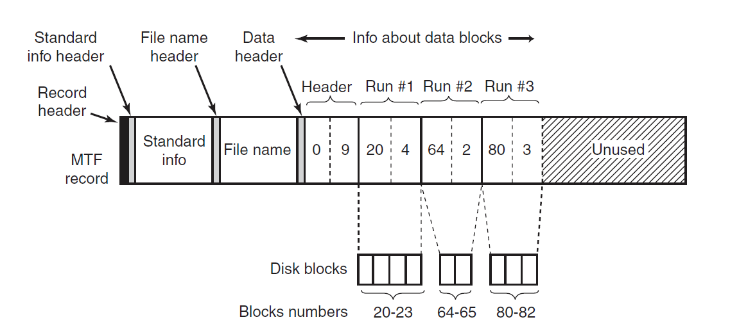
Master File Table of the NT File System
Source: [Tanenbaum 15]
ELC 467– Spring 2020
Lecture 10 -Page 3
Notes:
This is an example MFT record. The file is stored in three fragments, shown as three runs of cluster numbers: 4 clusters starting from 20, 2 clusters starting from 64, and 3 clusters starting from 80. Note that figure uses “blocks” to mean “clusters”.

Slide 6
Master File Table of the NT File System
Record contains the file’s attributes and a list of disk addresses where its clusters are located. Addresses are stored in the form of (disk address, run length) pairs.
If file is large and fragmented, additional records may be used to store remaining cluster addresses. Small files are stored entirely within the MFT record.
ELC 467– Spring 2020
Lecture 10 -Page 2
Notes:
If file is smaller than 1K (e.g. text file with few lines), it is not efficient to have a record of 1K to store location of these few data, with additional access to get data from disk. So the data is stored directly in the MFT record.

Slide 7
Master File Table of the NT File System
Record contains the file’s attributes and a list of disk addresses where its clusters are located. Addresses are stored in the form of (disk address, run length) pairs.
If file is large and fragmented, additional records may be used to store remaining cluster addresses. Small files are stored entirely within the MFT record.
Free space on disk is recorded by a bit map in a special system file.
ELC 467– Spring 2020
Lecture 10 -Page 2
Notes:
Bit map idea is similar to that discussed in memory management, with a bit for each cluster indicating if it free (0) or assigned to some file (1).

Slide 8
[Question] Free disk space can be kept track of using a free list or a bit map. For a disk with B blocks, of which F are free, state the condition under which the free list uses less space than the bit map, assuming that disk addresses require D bits. For D having the value of 32-bits, express your answer as a percentage of the disk space that must be free.
ELC 467– Spring 2020
Lecture 10 -Page 4

Slide 9


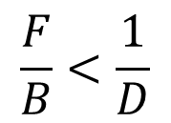
[Question] Free disk space can be kept track of using a free list or a bit map. For a disk with B blocks, of which F are free, state the condition under which the free list uses less space than the bit map, assuming that disk addresses require D bits. For D having the value of 32-bits, express your answer as a percentage of the disk space that must be free.
Size of bit map will be $B$ bits regardless of how much of disk is free. Free list will have a variable size of $FD$. Thus, free list is smaller if:
$$FD<B$$
or
$$\frac{F}{B}<\frac{1}{D}$$
i.e. if ratio of free blocks on disk is less than a given threshold, 3.125% if D=32.
ELC 467– Spring 2020
Lecture 10 -Page 4

Slide 10
Disk Caching
Currently accessed disk blocks are stored into a cache area in RAM to increase their access speed.
ELC 467– Spring 2020
Lecture 10- Page 5
Notes:
Another technique to avoid slowing down the system by long disk access times is the technique of disk caching. Note that blocks are brought to “disk cache” area in main memory, not in cache memory.

Slide 11
Disk Caching
Currently accessed disk blocks are stored into a cache area in RAM to increase their access speed.
When a disk block is accessed, system looks for it first in cache. If missed, block is fetched from disk.
Overall access speed is improved if frequently accessed blocks are kept in memory.
ELC 467– Spring 2020
Lecture 10- Page 5

Slide 12
Disk Caching
Currently accessed disk blocks are stored into a cache area in RAM to increase their access speed.
When a disk block is accessed, system looks for it first in cache. If missed, block is fetched from disk.
Overall access speed is improved if frequently accessed blocks are kept in memory.
Caching is an effective technique whenever locality of access is present.
ELC 467– Spring 2020
Lecture 10- Page 5
Notes:
Locality of access means that normally process will not access whole of large files at the same time. At any time, it will need access to small parts of files only. It then moves to other parts after some time.

Slide 13
Disk Caching
A similar technique is used whenever there is a fast, small capacity storage medium and a slow, large capacity medium.
ELC 467– Spring 2020
Lecture 10- Page 6
Notes:
For example, the same idea is used at another level between main memory and cache memory. Note that disk caching complements virtual memory, which moves unused memory contents to disk. Thus, the relatively fast main memory will hold both memory pages and disk blocks that processes currently needs. Unused memory pages and disk blocks are kept on disk.

Slide 14
Disk Caching
A similar technique is used whenever there is a fast, small capacity storage medium and a slow, large capacity medium.
Design Considerations:
Size of cache buffer.
If cache is full, how to replace blocks?
If a block is modified in cache, when to update it on disk?
ELC 467– Spring 2020
Lecture 10- Page 6
Notes:
Large cache buffer in memory allows holding more blocks, thus increasing hit ratio, but will take large portion of memory needed by processes. LRU is again a good replacement policy. If a modified block is updated on disk only when removed from cache, probability of error resulting from failing to update increases. On the other hand, immediate updating when change is made reduces error probability but slows down operation. A compromise solution can be frequent periodic updating.

Slide 15
Disk Scheduling
Several concurrent processes may access different files on the same disk. These files may be stored on distant cylinders.
ELC 467– Spring 2020
Lecture 10- Page 7
Notes:
One last technique is needed if several processes are heavily accessing multiple files from the same disk at the same time.

Slide 16
Disk Scheduling
Several concurrent processes may access different files on the same disk. These files may be stored on distant cylinders.
Under heavy loads, handling access requests using a FCFS policy will result in very long access delays.
Thus, a better scheduling of the pending requests can improve performance.
ELC 467– Spring 2020
Lecture 10- Page 7
Notes:
Pending requests means requests to read or write specific sectors, not yet performed because disk controller is busy fulfilling previous requests.

Slide 17
Disk Scheduling
Several concurrent processes may access different files on the same disk. These files may be stored on distant cylinders.
Under heavy loads, handling access requests using a FCFS policy will result in very long access delays.
Thus, a better scheduling of the pending requests can improve performance.
Example:
Consider the following queue of track requests:
98,183,37,122,14,124,65,67
Currently head over track 53.
ELC 467– Spring 2020
Lecture 10- Page 7
Notes:
This means that there are 8 access requests from the shown track numbers not yet performed. They are placed in a queue by the order of their arrival. We focus here on reducing seek delays, but rotational delays can similarly be handled.

Slide 18
Disk Scheduling
Using FCFS
Source: [Silberschatz 14]
ELC 467– Spring 2020
Lecture 10- Page 8
Notes:
If the requests are fulfilled by the order of their arrival, disk arm will keep moving back and forth as shown. The total number of tracks moved, which is a measure of delay is 640 (45 from 53 to 98 plus 85 from 98 to 183, ….etc.) It is clear that reordering of requests can reduce this total delay. We will not try to find absolute minimum delay, as this will require trying all possible orderings of requests, which is not practical for large queues.

Slide 19
Disk Scheduling
Seek Optimization Methods:
Shortest Seek Time First (SSTF):
start with the request to the nearest cylinder.
ELC 467– Spring 2020
Lecture 10- Page 9
Notes:
SSTF moves to the nearest cylinder first, whether with smaller number or larger number. SSTF will be better than FCFS, but as it looks only at the next step it need not achieve the minimum delay. Probably going to a distant cylinder first may reduce the total delay.

Slide 20
Disk Scheduling
Using SSTF
Source: [Silberschatz 14]
ELC 467– Spring 2020
Lecture 10- Page 10
Notes:
In the example, SSTF will serve requests in the shown order. Total number of tracks moved is reduced to 236.

Slide 21
Disk Scheduling
Seek Optimization Methods:
Shortest Seek Time First (SSTF):
start with the request to the nearest cylinder.
Scan (elevator) algorithm:
move head in one direction, as long as there are requests in that direction. Otherwise, reverse direction.
ELC 467– Spring 2020
Lecture 10- Page 9
Notes:
SSTF may cause very long delay for some requests of distant cylinders, if requests to nearby cylinders keep coming. This is improved in the scan algorithm, moving head in one direction only if there are requests in this direction. Requests to distant cylinders are expected to be served after shorter delay than SSTF. In problems, initial direction (e.g. towards larger numbers) need to be known.

Slide 22
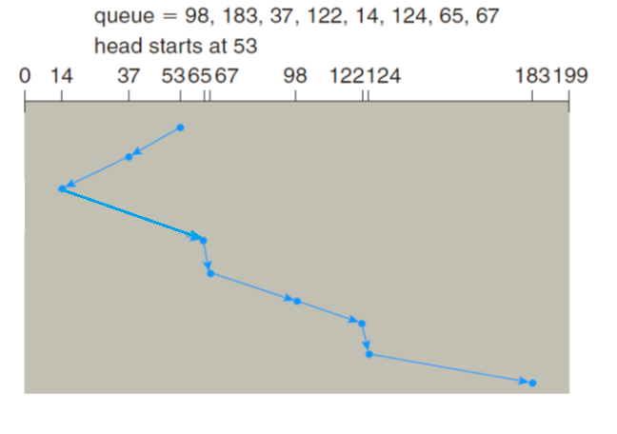
Disk Scheduling
Using SCAN
Source: [Silberschatz 14]
ELC 467– Spring 2020
Lecture 10- Page 11
Notes:
This is the example using scan assuming that head is initially moving towards smaller numbers. Total number of tracks moved is 208. Note that it is less than SSTF. Although this will not always be true, it indicates that SSTF will not always minimize the delay.

Slide 23
Disk Scheduling
Seek Optimization Methods:
Shortest Seek Time First (SSTF):
start with the request to the nearest cylinder.
Scan (elevator) algorithm:
move head in one direction, as long as there are requests in that direction. Otherwise, reverse direction.
Circular Scan Scheduling:
similar but movement is in one direction only. Move to opposite end instead of reversing direction
ELC 467– Spring 2020
Lecture 10- Page 9
Notes:
A slight modification is made in circular scan. When scan reaches one end, we expect requests that waited longer are those at the other end. Circular scan move to those first, and hence expected to have better average delay for requests.

Slide 24
Disk Scheduling
Using C-SCAN
Source: [Silberschatz 14]
ELC 467– Spring 2020
Lecture 10- Page 12
Notes:
This is the example using circular scan, assuming arm moves always towards larger numbers.

