Slide 1
Animation of Reflection and Transmission
Tamer Abuelfadl

Slide 2
Normal Incidence on a Perfect Conductor
Perfect Conductor Boundary

Slide 3
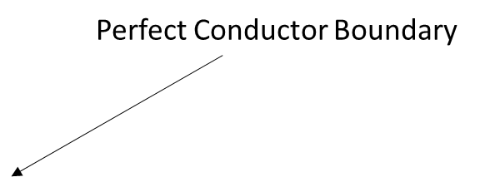
Oblique Incidence on a Perfect Conductor

Slide 4
Oblique Incidence Parallel Polarization
Dielectric Boundary
Medium 2

Slide 5
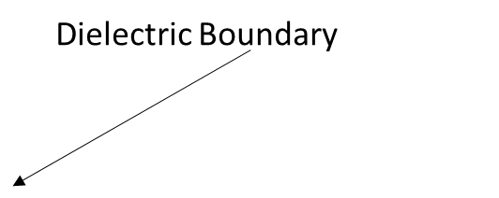
Oblique Incidence Parallel Polarization at Brewster Angle

Slide 6
Parallel Polarization incidence at Critical Angle

